Slide 1
JAIST PPT Template
User Guide
Designed by:
Lin Wensheng
Mail:
linwest@jaist.ac.jp
2017/3/16

Slide 3
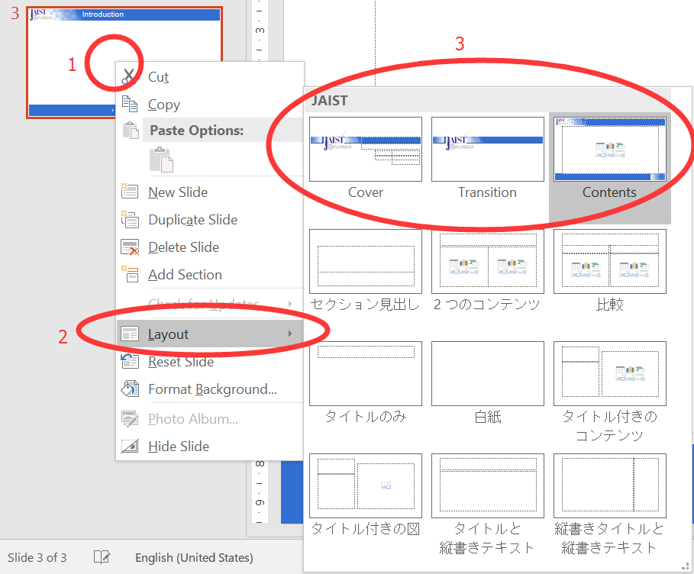
Introduction
Thank you for downloading JAIST PPT Template.
You can use it for free.
There are 3 kinds of layout:
Cover: this is cover page.
Transition: this is animation of transition from Cover to Contents.
Contents: this is common contents page.

